Slide 1
Face-mask & Social- distance detection
Group member: Eddy, Ronald, David
20-11-2020

Slide 2
Business Question
Data Collection & preprocessing
Face detection model analysis
Face mask detection model analysis
1
2
3
4

Slide 3
Distance measurement
Code explanation
Conclusion & Further improvement
5
6
7

Slide 4

Business Question
“Masks should be used as part of a comprehensive strategy of measures to suppress transmission and save lives”
World Health Organization (WHO)

Slide 5
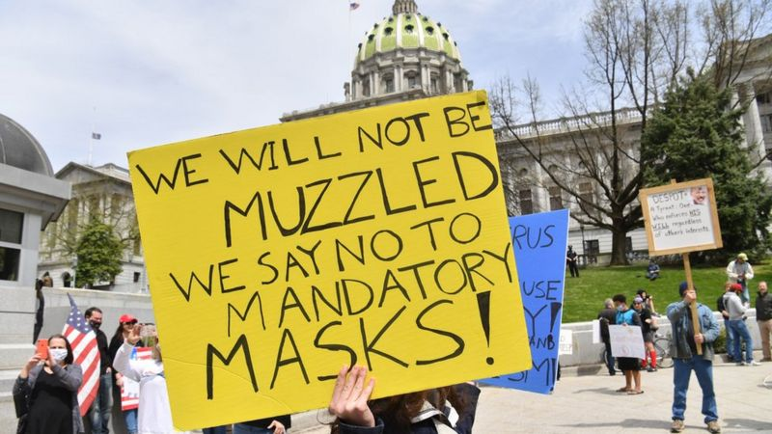
Business Question

Slide 6
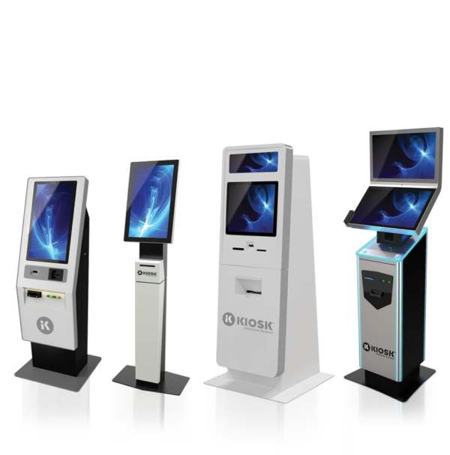
Business Question
Using AI technology to detect possible violation of mask wearing and social distancing rules so as to help prevent the spread of COVID-19.
Notes:
integrated into retail point-of-sales systems, security cameras, digital signage and other connected devices to determine that individuals in required areas are wearing a face mask, and notifying pre-designated personnel if they are not. As health officials continue to call for individuals to wear masks whenever they are in public to prevent the spread of COVID-19, facial recognition engines must evolve to help businesses, municipalities and other organizations remain compliant with these guidelines and protect people at large.

Slide 7
How it works
Face Detection
Our final Model
Social Distance Detection
Face-mask Detection
Notes:
integrated into retail point-of-sales systems, security cameras, digital signage and other connected devices to determine that individuals in required areas are wearing a face mask, and notifying pre-designated personnel if they are not. As health officials continue to call for individuals to wear masks whenever they are in public to prevent the spread of COVID-19, facial recognition engines must evolve to help businesses, municipalities and other organizations remain compliant with these guidelines and protect people at large.

Slide 8
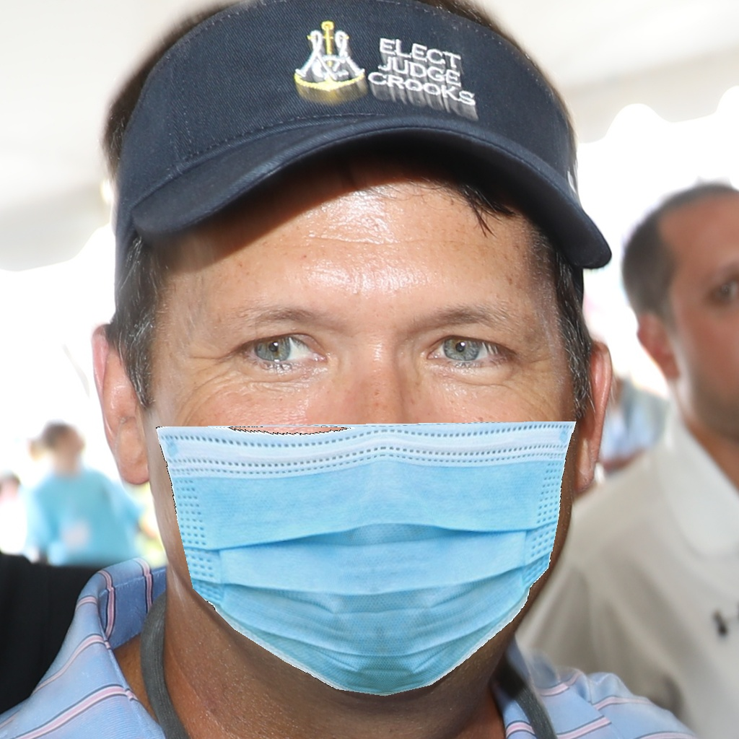
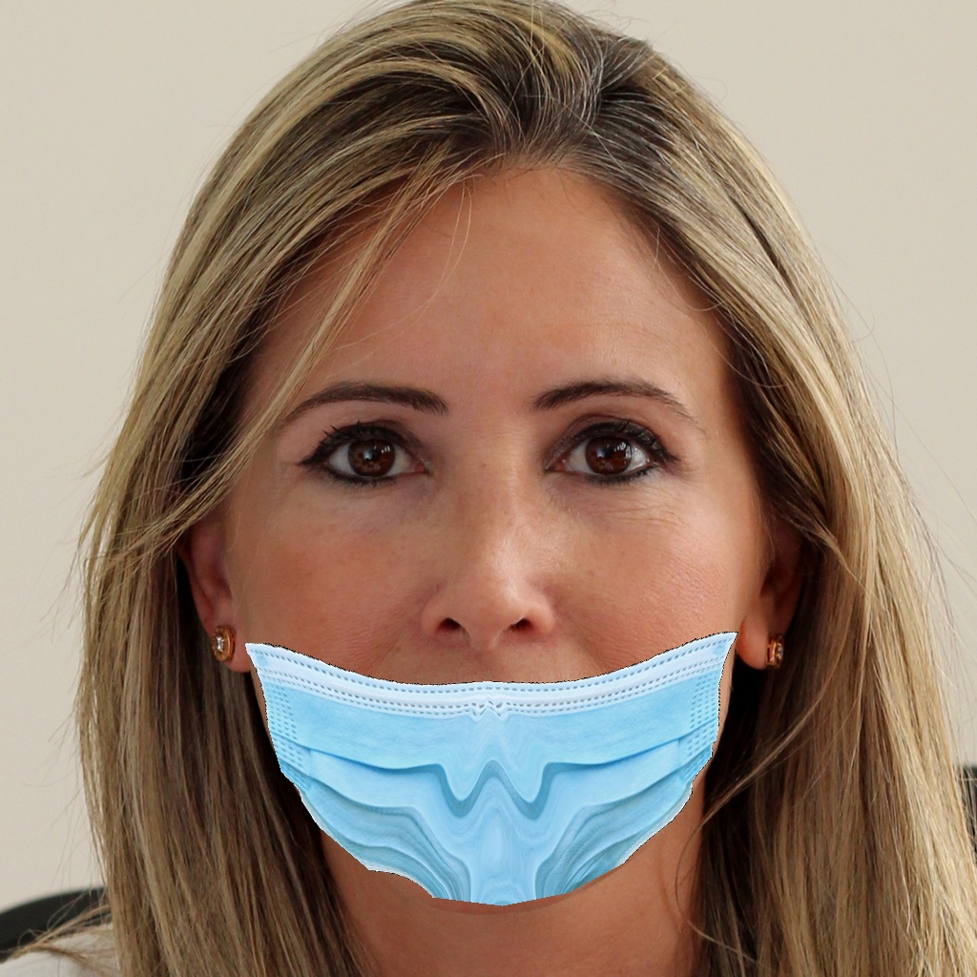
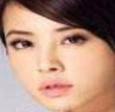
Data Collection

Slide 9
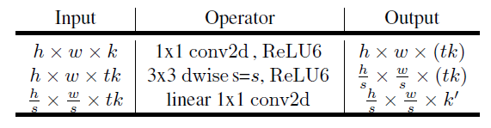
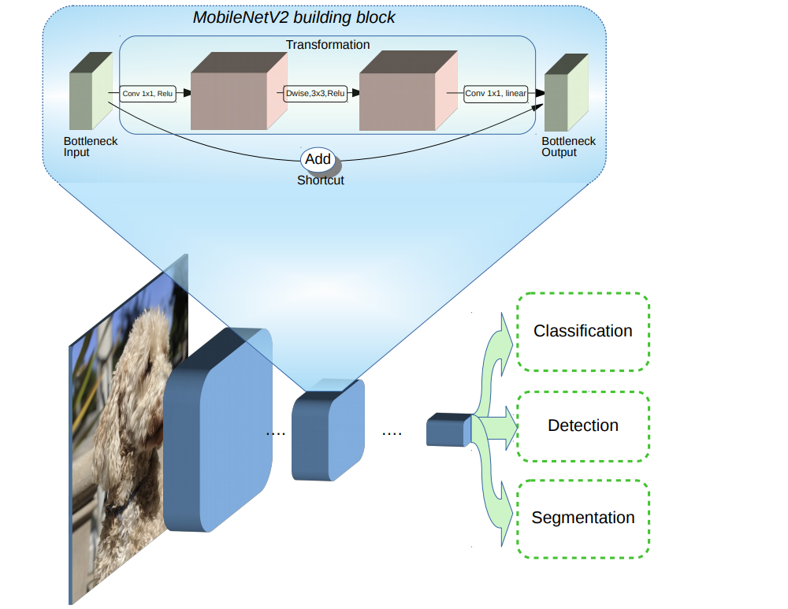
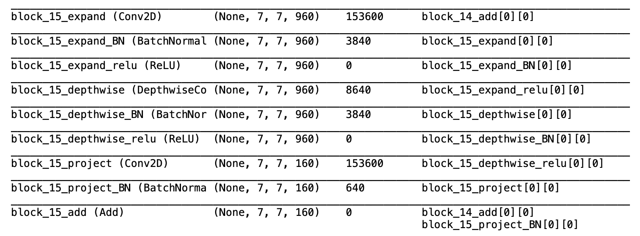
MobileNet V2
Notes:
For the MobileNet V2 pretrained model , ..simple model.. there are only 88 layers in total
So,it dramatically reduce the complexity cost and model size of the network
Suitable for the devices with low computational power.

Slide 10
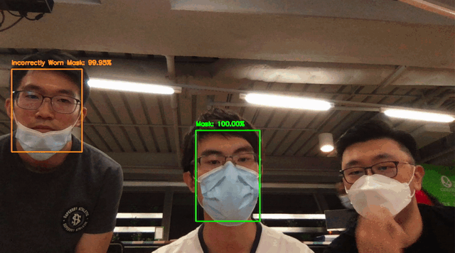
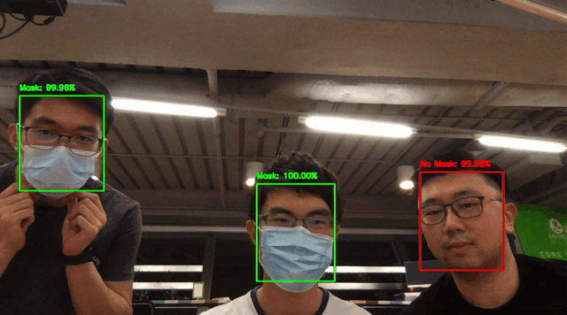
Demo
MobileNet V2

Slide 11
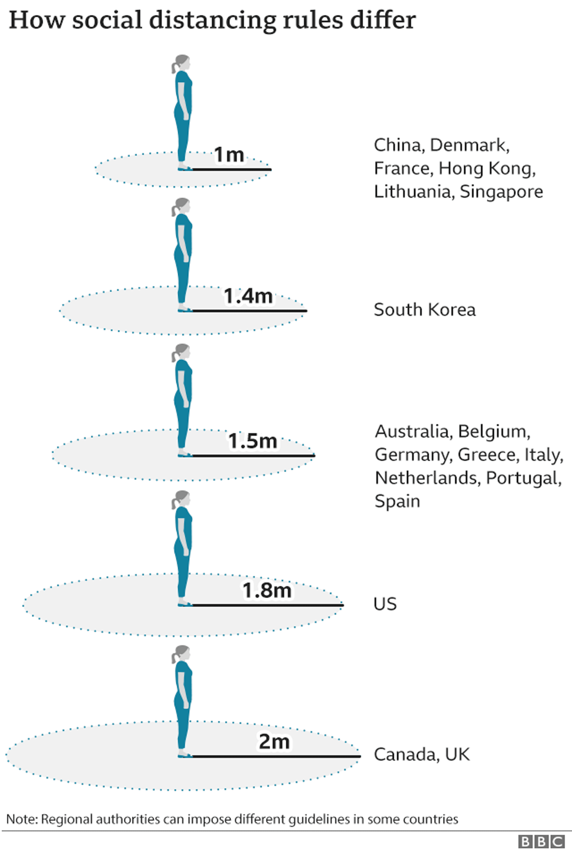
Distance Measurement
Calculate the distance between people using the coordinates of the bounding boxes drawn around the faces
Notes:
Next, I will talk about how we come up with the social distance measurement. This part is not actually very related to machine learning, but since we had done a mask classification model and deploy it, we think it is useful to add a social distance measurement into the application as well. So we actually calculate the distance between people by using the coordinates of the bounding boxes drawn around the faces.

Slide 12
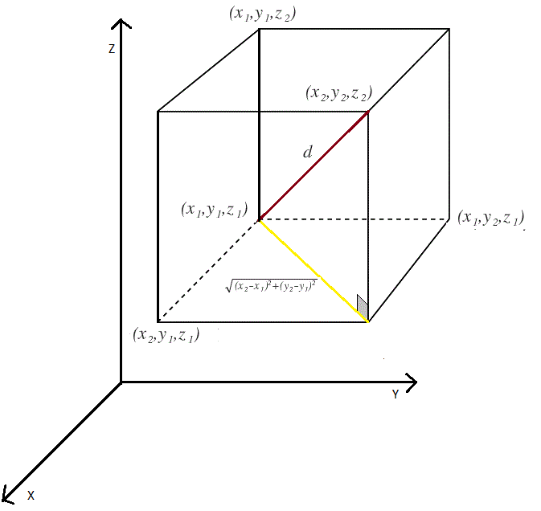
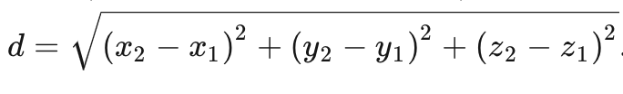
Distance Measurement
Calculate Euclidean distance in three dimensions
Notes:
We will calculate the euclidean distance in three dimensions using the formula shown here.

Slide 13
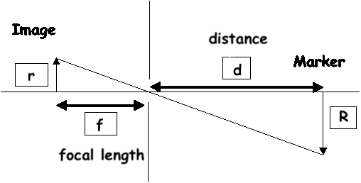
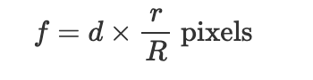
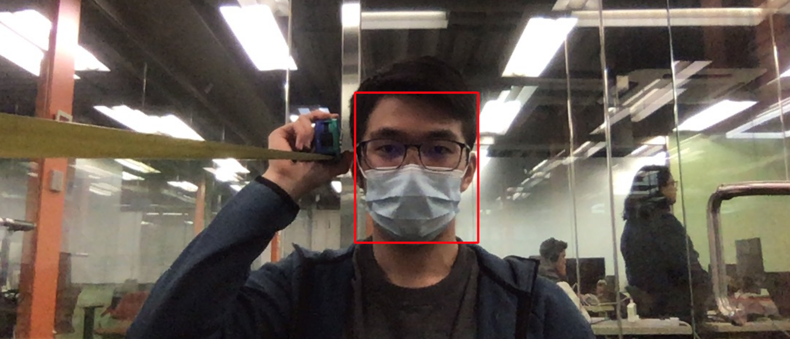
Distance Measurement
Before actually computing distance measurement:
Get the focal length of the webcam by calibrating it with an object with known width and known distance from the webcam
Notes:
And before actually deploying the app and computing the social distance, we have to the get the focal length of the web camera first by calibrating it with an object having a known width and known distance from the web camera. And then we can use this formula to get the focal length, and we found that it is around 800 pixels.

Slide 14
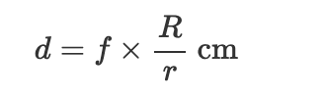
Distance Measurement
After getting the focal length:
Get the distance from the webcam, which will be the z-coordinate
And convert the x and y coordinates from pixels to cm
Notes:
Then when we actually deploy the app, the face detection model would return us the x and y coordinates in pixels of the faces. Then we can use the x and y coordinates in pixels to get the width of the face in pixels, which will be the r in lowercase as shown in the formula. Then we can use the focal length calculated and assumed face width, which is around 20cm, and the width of the face in pixels to get the distance of the face from the webcam, which will be the z coordinate. We can also convert the x and y coordinates from pixels to cm using the second formula, with the distance from camera we just calculated. At last, we will have the x, y, and z coordinates of each face in centimetres, and can calculate the distance between the faces.

Slide 15
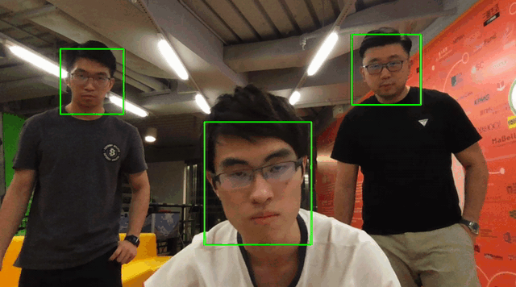
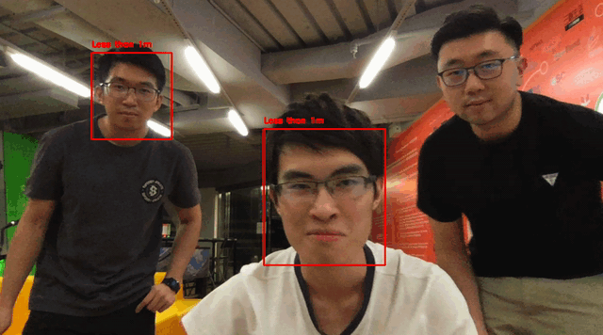
Demo
Social Distance Detection
Notes:
And this is our result, which shows a red bounding boxes when the distance between any two faces is less than 1m, or else shows a green box.

Slide 16
01
Display & next frame
Pre-process frame
Combining Mask Wearing Classification Model and Social Distance Detection Model:
05
Programme
Overflow
02
Detect # of faces
Bounding box & text
04
03
Face-mask detect
Distance estimate
Notes:
It’s the main code flow on how to display the face-mask detection on the screen.
After we convert the live-stream to image, first step is pre-process each image,
……...

Slide 17
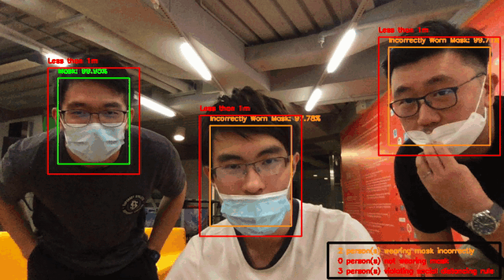
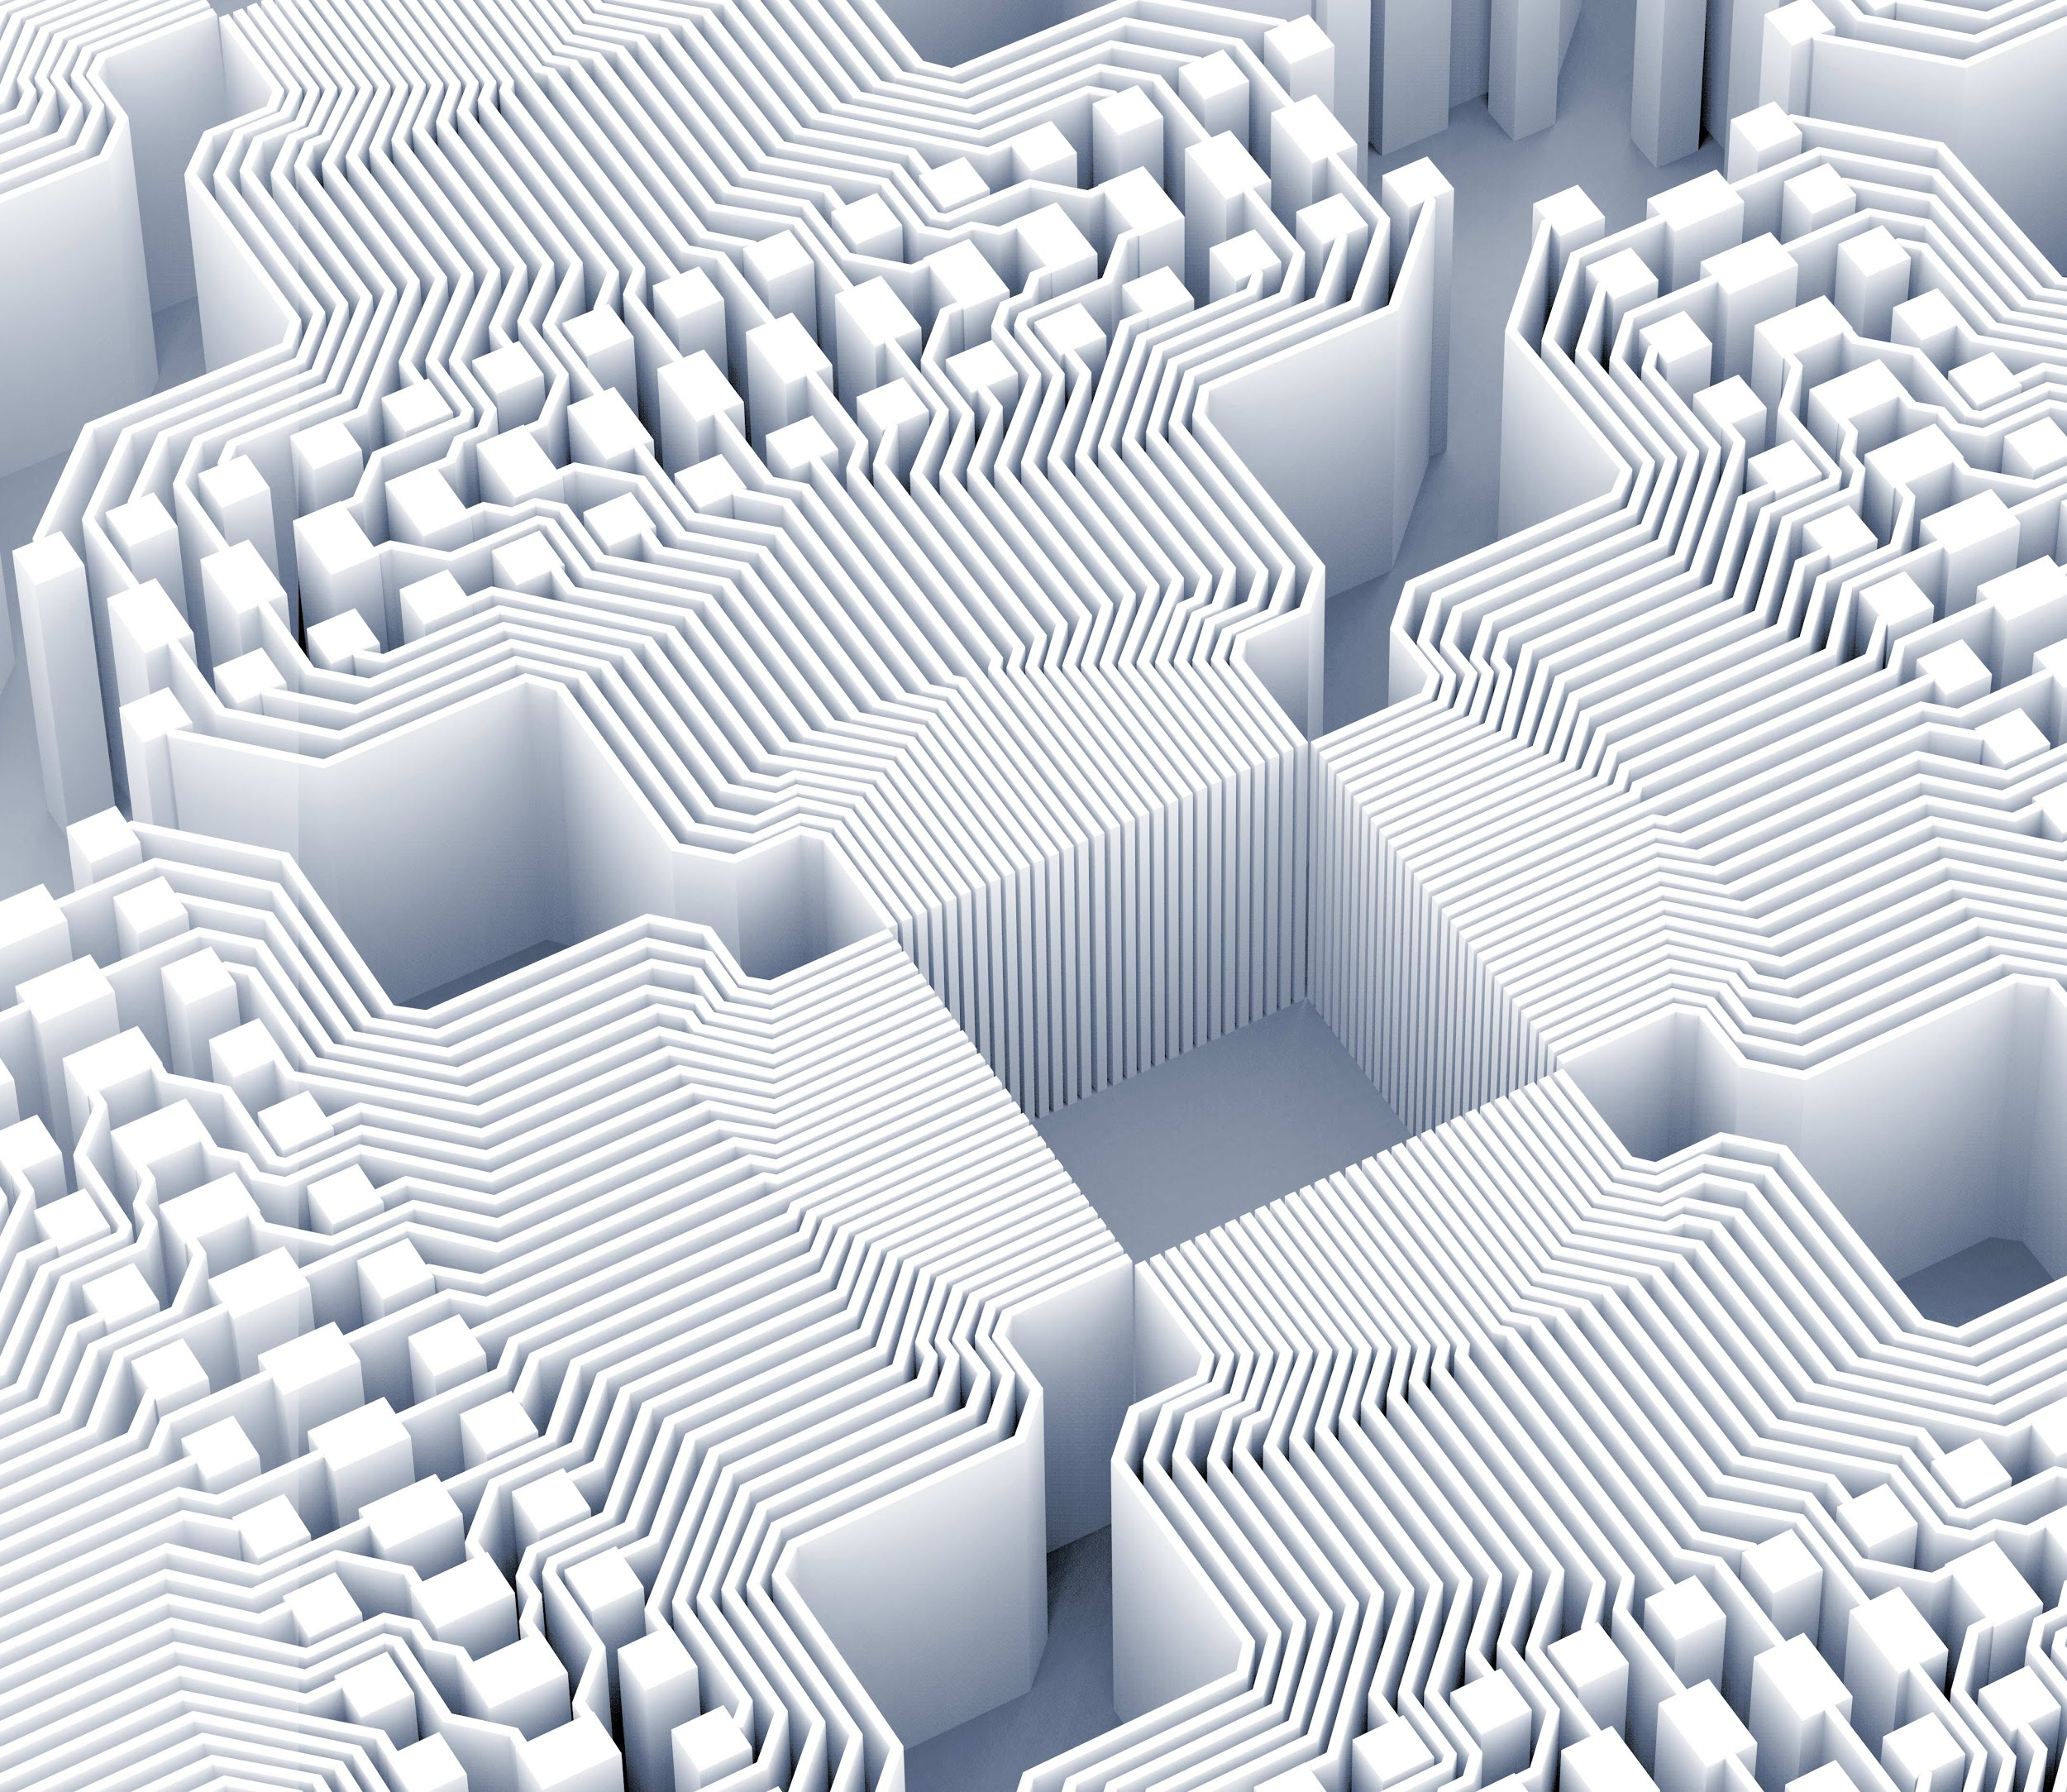

Slide 18
End

